Slide 1
Sub Routines – Void Functions (Procedures)

Slide 2
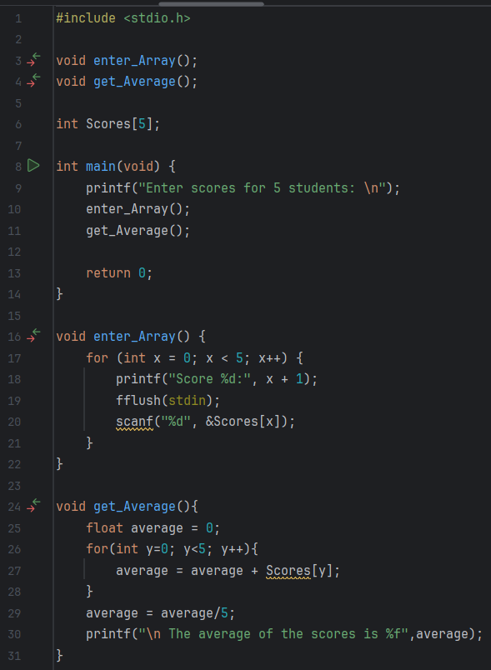
Predict
What do you think this code does?
Asks the user to enter the scores for 5 students by calling the subroutine enter_Array. In a for loop it asks for the five values and stores them in an array. After that they are added together and divided by 5 in the function get_Average so the program can then output the average.

Slide 3
Run
What does the code do?
Asks the user to enter the scores for 5 students by calling the subroutine enter_Array. In a for loop it asks for the five values and stores them in an array. After that they are added together and divided by 5 in the function get_Average so the program can then output the average.
Does this match your prediction?
Yes.
Download the code from Github and run it!

Slide 4
Investigate
Investigation Activities
What are the name of the variables being used? X,y, average What data types do they hold? X and y hold integer and average is real What are the names of the functions? Enter_Array and get_Average What type of data do these return?integer Annotate lines 4-30 to explain what each line of code does.

Slide 5
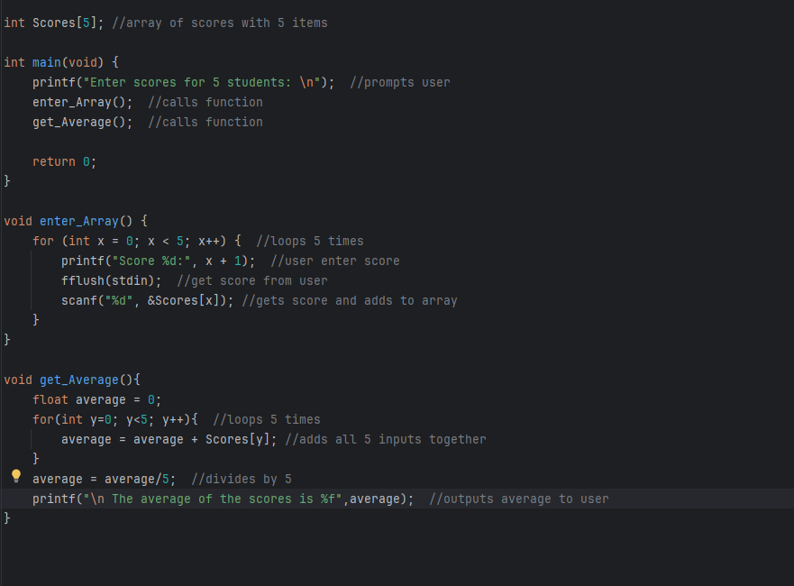

Slide 6
Modify
Modification Activities
Modify the program to ask the user to input 10 numbers instead of 5. Modify the program to find the lowest mark in the array. Modify the program to find the highest mark in the array. Modify the program to find the mode of the numbers input.

Slide 7
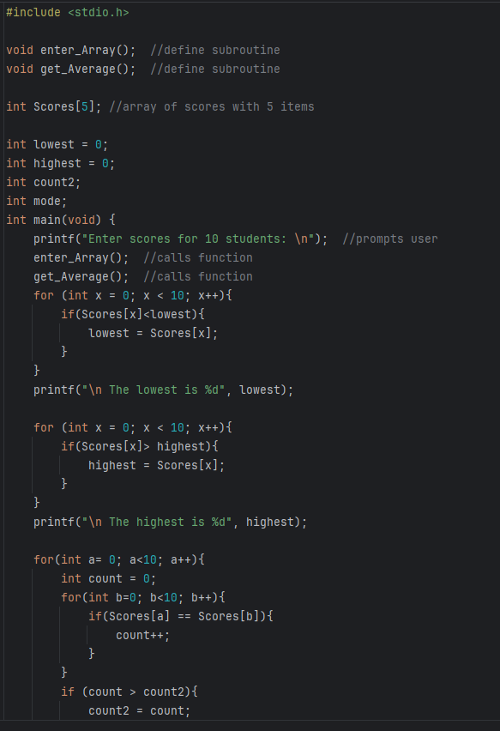
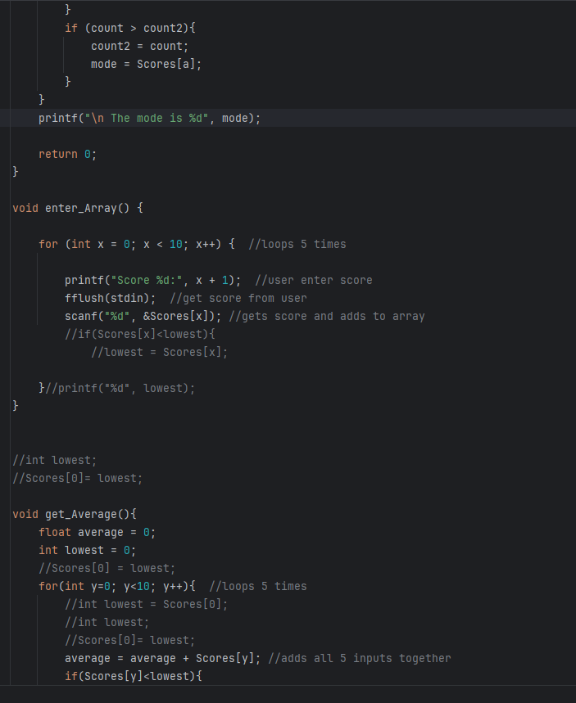
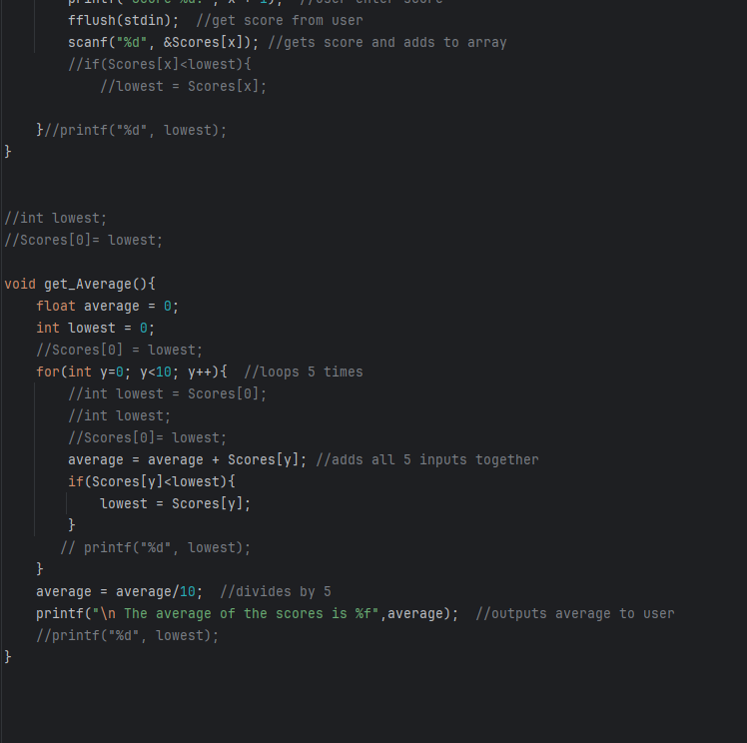

Slide 8
Make
Make Activities
Write a program that uses a sub-routine called testCount() which will use a loop to count up to a set value and show a message after each loop. Requirements: The program should ask the user what number to count up to Call the testCount() function, passing the input as a parameter The function should use a suitable loop to count up to that value It should output a message to screen during each loop showing each increment of the number When the subroutine is complete, the main program should output a message stating “Void function complete”.

Slide 9
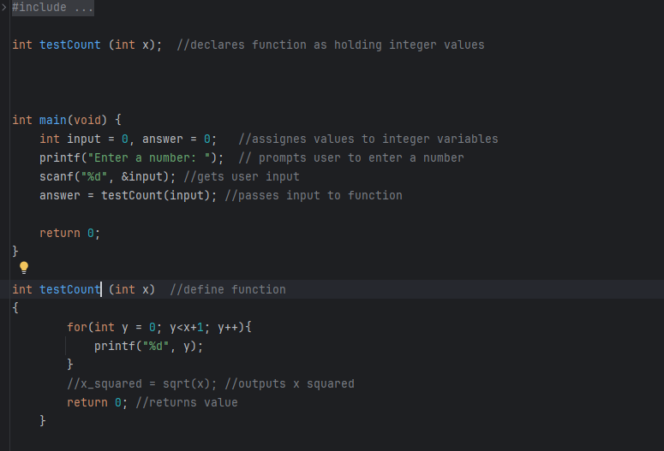

Slide 10
Make
Make Activities
Write a program that uses a sub-routine called power() which will use a loop to raise a base value to a specific power e.g. 3⁷. Requirements: The program should ask the user for: a base number – this should be stored as a global variable A power value (this should be an integer) Call the power() function, passing the power value as a parameter The function should use a suitable loop to multiply the base number the correct number of times to find the power e.g. 3x3x3x3x3x3x3 The function should return the final value to the main program The main program should output a message showing the original values and the output e.g. “3 to the power of 7 = 2187”.

Slide 11
